Slide 1

Distributed Meeting
Scheduling System
BY: TEAM BACON

Slide 2
Team Member
Andy Shih
Clement Ho
Justin Williams
Russell Durham
Ryan Compere
Ryan Howard
Ryan Plauche

Slide 3
Overview
Project Goal
Process
Functional Requirements
Non-Functional Requirements
New Issues in Phase II
Project Demo

Slide 4
Project Goal
To build a user-friendly software system, the Distributed Meeting Scheduling System (DMSS) that:
  Manages meetings in the user’s schedule
  Determines the best possible time and location
  Resolves scheduling conflict
  Allows manual meeting re-planning

Slide 5
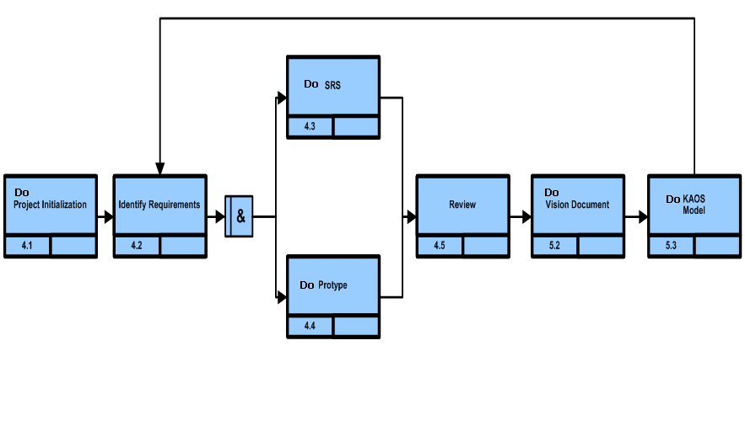
Process

Slide 6
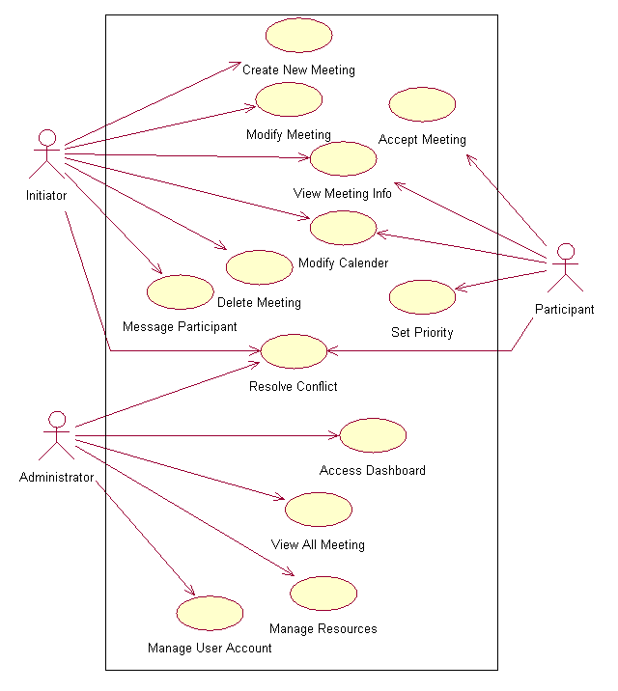
Functional Requirement
Use – Case Diagram

Slide 7
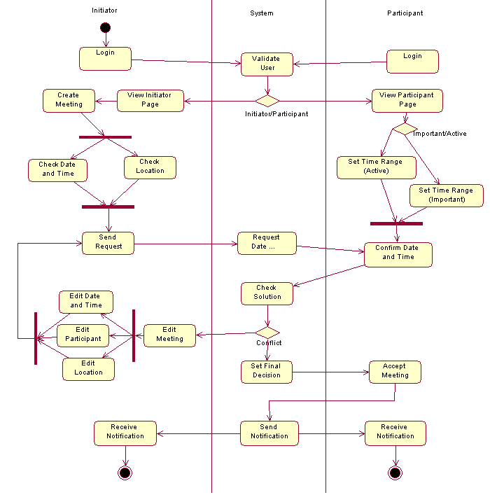
Functional Requirement
Activity Diagram

Slide 8
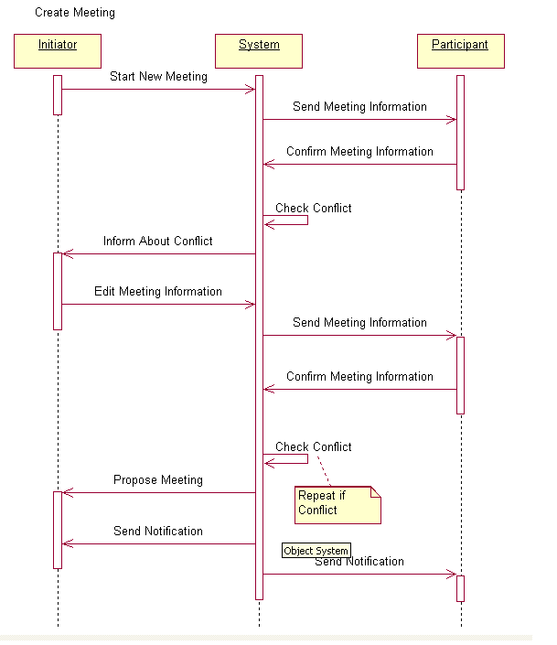
Functional Requirement
Sequence Diagram for Creating Meeting

Slide 9
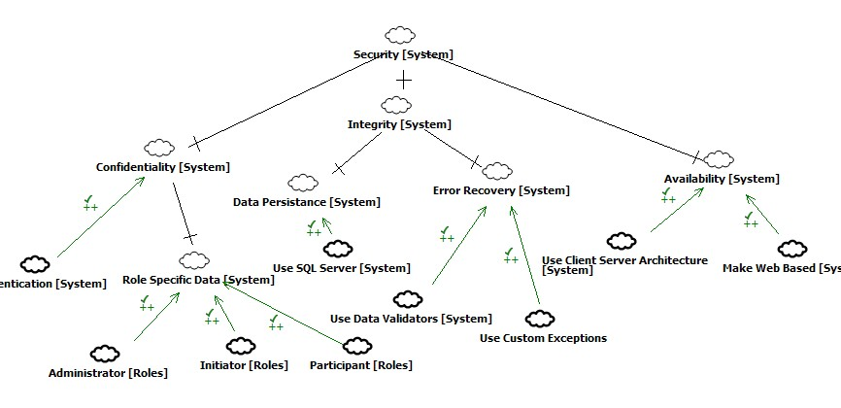
Non – Functional Requirement
Security

Slide 10
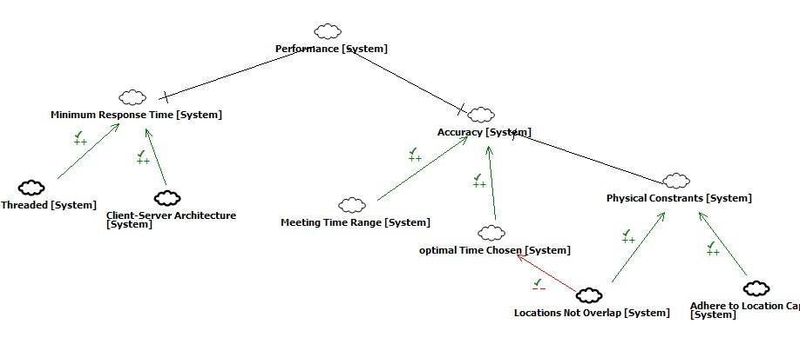
Non – Functional Requirement
Performance

Slide 11
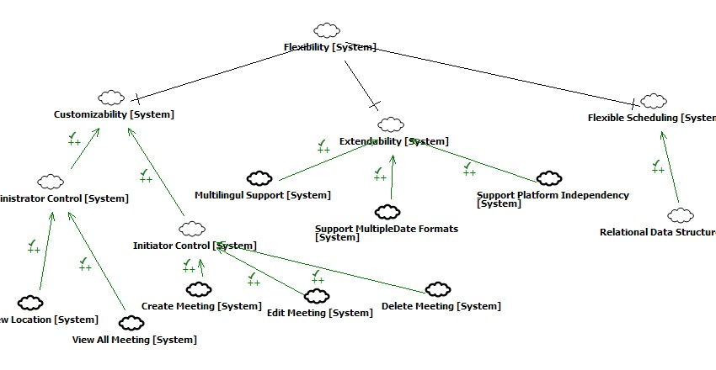
Non – Functional Requirement
Flexibility

Slide 12
New Issues in Phase II
Meeting information should be secure
Include outlook features

Slide 13
Project Demo

Slide 14
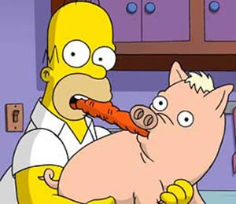
Any Questions?

